Slide 1
COVID CONTINGENCY PLAN FOR EMPLOYEES
Dr.Banushree,MD
Dr.Rekha , Dr.Sai Dheera
Aravind Eye Hospital,Madurai
Dated:1/6/2020

Slide 2
Measures to be taken for Employee Safety
COVID 19 Consent form
Training - To create awareness and educate regarding proper practices
Staff–instruction pamphlet –precautions to be taken at home
Staff with fever are advised not to attend duty
Identifying high risk group – older age, co- morbid conditions (Diabetes,Hypertension,COPD,CAD,Stroke,Malignancy,Pregnancy,On Immunosuppresants.Smoker)

Slide 3
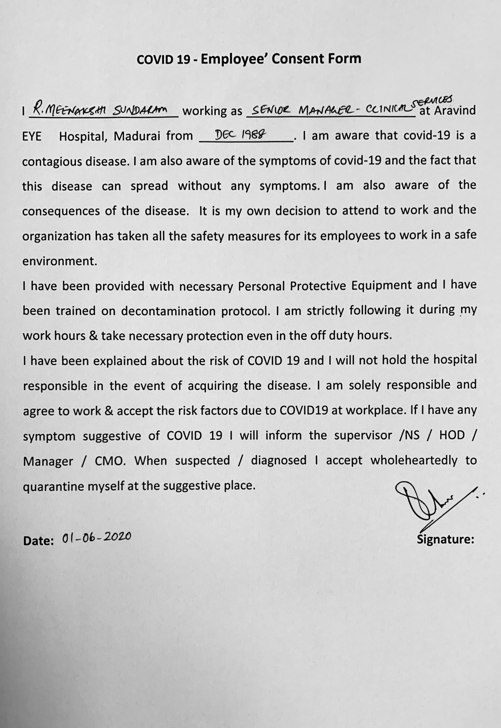
Covid -19 Consent form for Staffs

Slide 4
Training Module
Classes for MLOP’s to create awareness regarding PPE, clinical and disinfection protocols to be followed
Housekeeping-Cleaning and bio medical waste management protocols
Training programme are ongoing for MLOP’s regarding Instrument & Equipment cleaning protocol
Hospital Infection Control (HIC) classes

Slide 5
Employee Screening
Thermal screening –Inform only if there is an abnormality during screening
Symptoms history – to be monitored
Contact / Travel history
Residence in containment zone
History of fever among family members

Slide 6
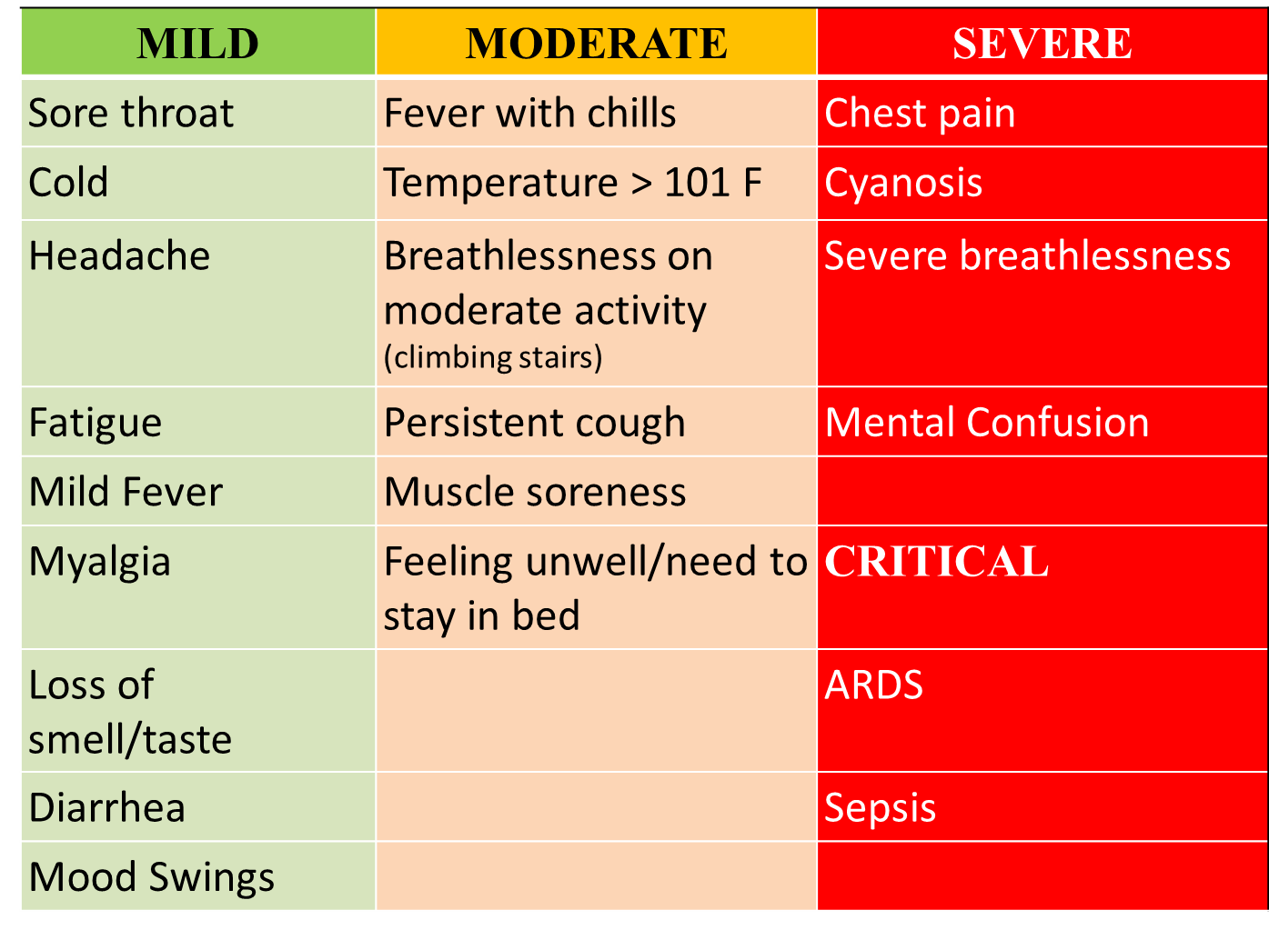
Symptoms questionnaire

Slide 7
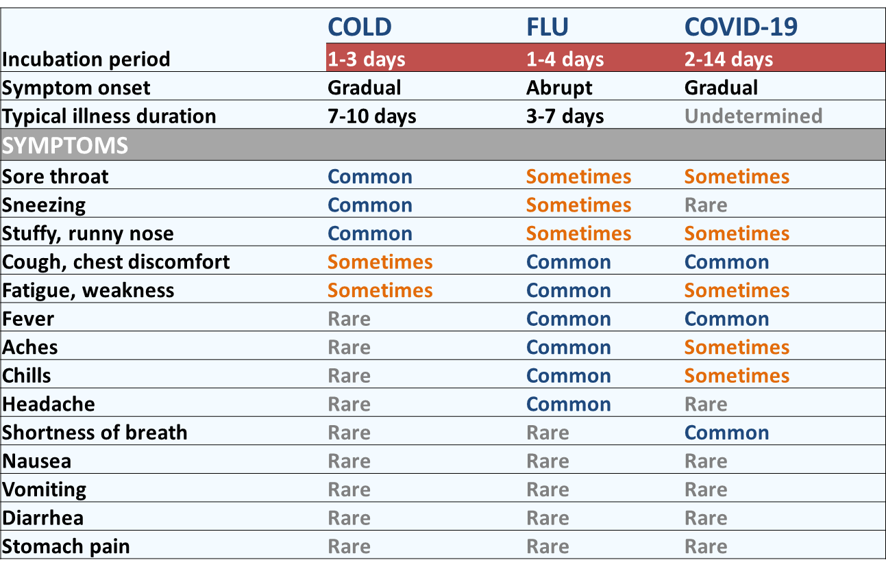
COLD-FLU-COVID-19: Comparison of symptoms

Slide 8
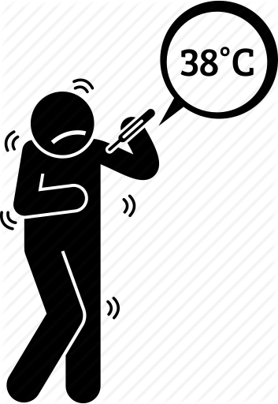
Thermal screening
High repeat 2 times > 38º C or
> 100℉ ( exclude ext temp heat)
In case of abnormality, MLOP in charge of thermal screening to inform physician immediately
Physician assessment - if vitals stable and lungs clear
Paracetamol and Antibiotic if needed (secondary infection ) Tab.Azithral 500mg OD for 5days or Cap.Amoxycllin and Clavunic acid 625mg BD

Slide 9
Covid suspect employee-
Immediate hospital admission criteria
(Govt. Rajaji Hospital, Madurai)
Respiratory distress
Chest pain
Spo2< 94%
Cyanosis
Mental confusion

Slide 10
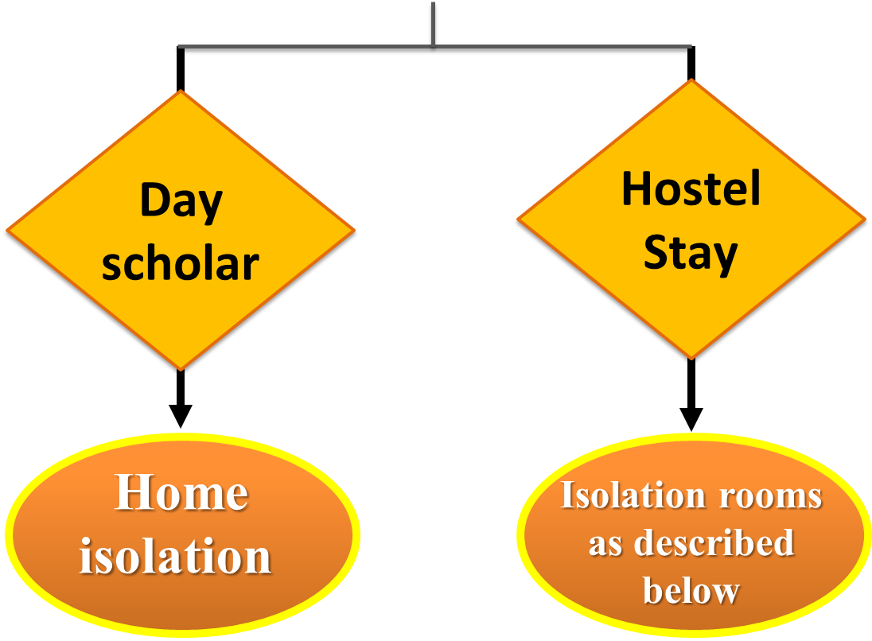
Protocol for mild-moderately symptomatic staff

Slide 11
Day scholars
Sent home for home isolation
Social distancing at home ,HR to follow up daily with telephonic summary
Explain about Self isolation to be followed in all activities
Proper disposal of mask and self monitoring

Slide 12
Hostel stay
MLOPs: Isolation in sick room (IP building - 5th Floor - Eastern side -10 rooms)
Doctors: Individual room with attached bathrooms (Eastern side of 5th Floor in IP building-10 rooms)
Daily: SpO2, vitals and temperature twice a day ( non contact or own thermometer ) monitoring done by staff nurse / PG doctor with PPE(Gown,Face shield,Respirator,Gloves)
To maintain separate register for MLOPs by hostel warden, for Doctors by Staff nurse / Dr.Sarveshwaran

Slide 13
Location for Examination | Isolation
Category | Examination | Isolation
Doctors | 1st Floor-ER Room Or VIP Room in Ground Floor | Individual room (IP block – Eastern side of 5th floor)
MLOPs
Admin/ Day Scholar staff
 |  | Home isolation

Slide 14
Facilities to be maintained
BP apparatus
Stethoscope
Non contact thermometer
Pulse oximeter
Crash cart/Emergency medicines available in the 5th floor to be used
Register and checklist to be maintained daily by staff nurse and in-charge sister of the floor

Slide 15
Investigations
When to do?
Investigations to be done?
Fever > 3 days
Shortness of breath
Drop in saturation
Complete blood count-to look for lympochytopenia (<1000 cells/Cu.mm), Neutrophil:lymphocyte ratio > 3:1
Chest X-ray PA view

Slide 16
INVESTIGATIONS
Blood reports and X ray chest
NORMAL
SUSPICIOUS
ONLY OBSERVATION
CT CHEST,
RT-PCR

Slide 17
Critical Alert Indicators
Shortness of breath
High fever >101 F
Cyanosis
SPO2 less then 94 %
Respiratory rate > 24
Single breath count < 30/mt

Slide 18
Return to work
No fever/ symptoms for 3 days or 10 days from onset of illness - no need to repeat the test for mild to moderate cases
If it is severe or critical, which required hospital admission, repeat PCR needs to be done before joining duty

Slide 19
Protocol: Ocular examination for a known Covid-19 patient/High suspect
To be done in case of ocular emergency where examination and treatment is mandatory
Patient with proper mask on to be shifted immediately by attending healthcare worker to an isolation room (Ground floor-VIP room), notification to COVID-19 task force personnel and physician to be done via phone immediately
Ophthalmology/Physician assessment to be done under necessary precautions and proper PPE

Slide 20
Protocol contd…
History and minimal examination if patient stable -No other healthcare worker to enter to minimize contacts, no public announcement to be made
Nodal officer to be notified regarding the patient’s visit -who will co ordinate with concerned local authority – so that patient will be shifted immediately to Govt Hospital in their own ambulance.

Slide 21
Risk stratification of employees in our hospital
LOW RISK
MODERATE
HIGH RISK
.
Security
Enquiry Desk
Escorting
Medicals
Cash counter
House Keeping
Admin
Electrician
Sanitary Workers
Catering
Stores
Drivers
Triage Doctors
Triage MLOPs
Refraction
BP and Duct-Investigations
Optical staff
GA staff
OT
Ambulance staff, Lift operators
Thermal screening
Dispensing of Antiseptic
Registration
Vision screening
Central Fields
Counselling

Slide 22
Risk stratification of employees after exposure to suspected COVID patient:
High risk contact:
Performed aerosol generating procedures without appropriate PPE.
HCWs without mask/face-shield/goggles: having face to face contact with COVID-19 case within 1 metre for more than 15 minutes
Having accidental exposure to body fluids of COVID suspect/case
Low Risk contact:
-- Contacts who do not meet criteria of high risk exposure

Slide 23
Staff Exposed
High Risk
Low Risk
To be tested, and quarantined at home for 14 days with Hydroxychloroquine (HCQ) prophylaxis after ruling out pre-existing contraindications.
Self monitor closely
RT-PCR –
Test Positive
Can resume work
Asymptomatic/
Mild-continue home quarantine with HCQ.
Moderate-Severe symptoms-shift to designated COVID centre

Slide 24
Quarantine policy for staff who came in contact with a patient who became positive after Hospital visit
Patient positive:
Trace movement register :
Route card and EMR for OP, Counsellors, IP and OT.
Those who are not logging in and coming in contact with the patient should write their full name with initials in the route card
Route card should be collected from the final stage, scanned and uploaded in the EMR
Concerned clinic coordinators are responsible for the collection and uploading in the EMR

Slide 25
Quarantine policy for staff who came in contact with a patient who became positive after Hospital visit
SOP for Healthcare workers quarantine/Treatment:
Identify staff- isolate at home / hospital in designated areas as previously stated
Risk assessment of staff to be done-Whether staff were using appropriate PPE by given designated form (Refer the form in the next slide)

Slide 26
Risk Assessment Form

Slide 27
Quarantine policy continued…
Do RT - PCR (Done in Covid dedicated health centre)
If Staff turns positive-Tracing contacts of staff- close contact at hospital(>15 mins direct contact without appropriate PPE) and at home-people living together,travelling together,socialising events,neighbours.

Slide 28
Sterilisation of Room
Rooms to be sterilized after isolation/quarantine
Disinfection of the exposed hospital areas.
- Hydrogen peroxide fumigation of room-20 mins
- 1% Lysol for floor
- 1% Sodium hypochlorite for bathroom
- 70% Isopropyl alcohol for instruments
Rooms can be reused after 24 hours.

Slide 29
Return of Staff
If returning from other states-to follow local district guidelines
Self quarantine ( if needed) -14 days - Home/ Hostel
PCR and antibody negative -return to work

Slide 30
References
Guidelines to be followed on detection of suspect/confirmed COVID-19 case in a non-COVID Health Facility, MOHFW dated 20.04.2020
Advisory for managing Health care workers working in COVID and Non-COVID areas of the hospital, MOHFW dated 15.05.2020
Revised Strategy for COVlD-19 testing in lndia. MOHFW dated 18.05.2020
Revised advisory on the use of Hydroxychloroquine (HCQ) as prophylaxis for COVID-19 infection, MOHFW, dated 22.05.2020

