Slide 1
Transmission characteristics of COVID - 19
Dr.Banushree
Physician

Slide 2
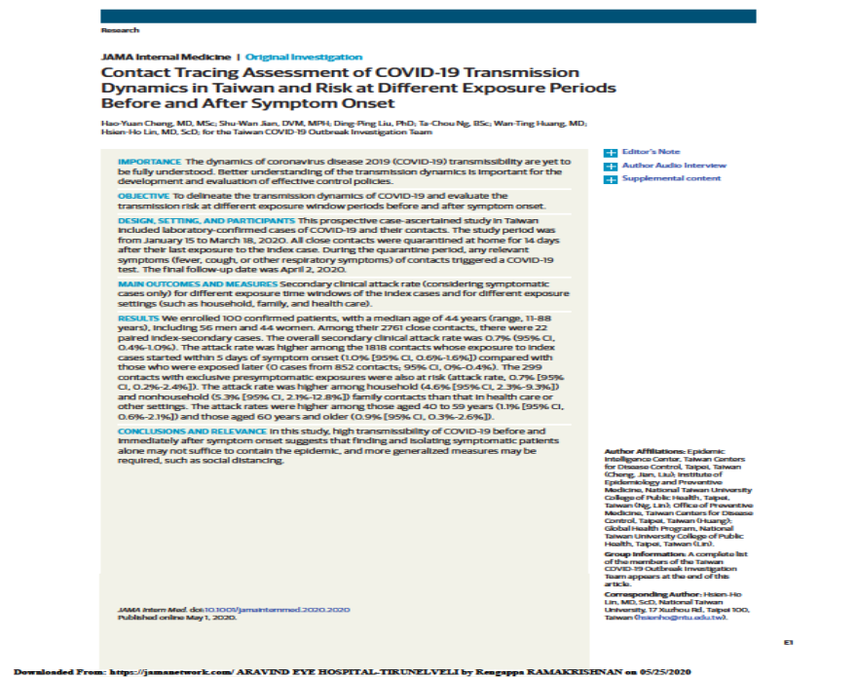

Slide 3
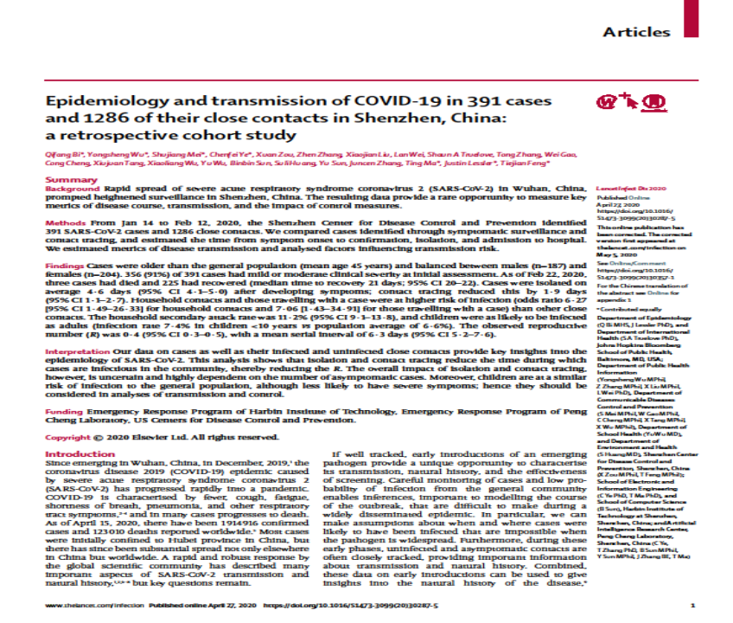

Slide 4
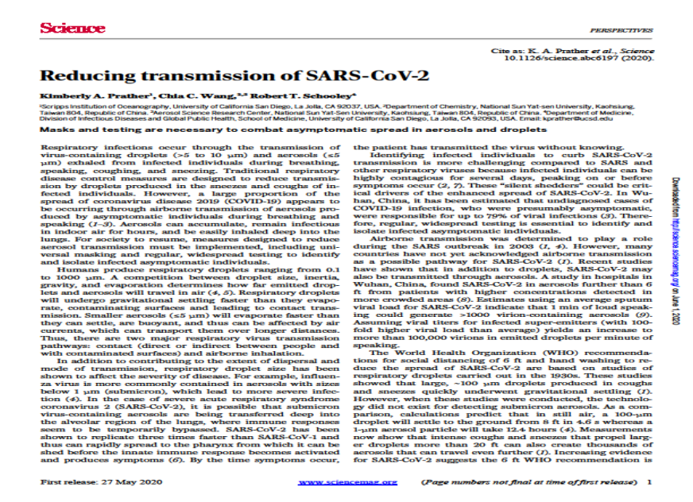

Slide 5

Transmission characteristics of Covid-19
Cough produces - both large 100-1000 microns) and small droplets (more 1-10 microns)
Speech produces – smaller droplets only
Smaller droplets – remain in air for 9 minutes before settling on ground
Aerosols – evaporate faster
Large droplets – settle faster

Slide 6

Room ventilation and droplets
Room with no ventilation – takes 5 minutes for droplets to reduce by 50%
Poor ventilation – 1.4 minutes
Well ventilated – 50% in 30sec

Slide 7
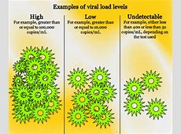
Viral load
Viral load – same for symptomatic , asymptomatic and minimally symptomatic
High viral load – around time of symptom onset – decrease after 10 days

Slide 8
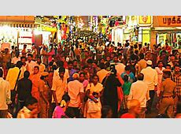
Three C –prevent clusters
Avoid closed spaces with poor ventilation
Crowded places
Close contact settings- close range conversation

